Slide 1

The Smart Cart
Presented by: Fords of Bellman

Slide 2
Our design consists of the following:
A physical cart.
A motor actuated platform and microcontroller.
Two QR/Bar code scanners one for updating the list when the item is added in and another for removing items from the list in case the customer doesn’t wants to take a particular added item.
Load Cell with amplifiers and microcontroller to cross validate the addition and removal of items.

Slide 3
Work Flow
Customer adds products into the Cart by placing them on the platform meant for scanning.
The product only when scanned for barcode is put inside the Cart, and the respective item is added corresponding to the customer's list.
For removing anything he/she has to remove the product and scan it against the external scanner.
The Customer pays for the products using the "shop balance" and exits the store.
Customer Scans his/her unique QR code against the scanner placed on Cart which logs in the particular person into that cart.

Slide 4
Certain What-ifs:
A product added without scanning?
- Servo motor can’t budge without scanning
A product removed without scanning from external scanner?
- Error message in Cart because load cell detects loss in weight
Removing different products of same price?
- Load cell & scanner makes sure only the “intented” product is taken out

Slide 5
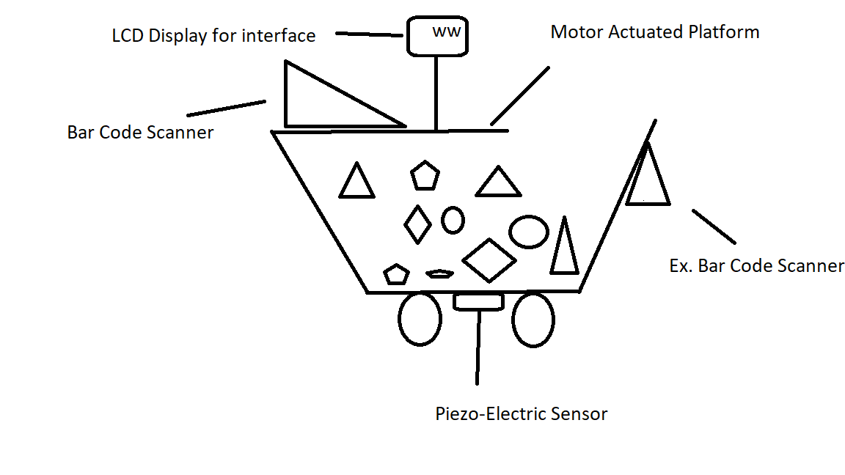
The Cart

Slide 6
Advantages over RFID:
Cost effective
No Advanced computational power or servers required
Implementation considerably easy since based upon QR code
Non damageable & more robust scanning technology

Slide 7
THANK YOU

